Slide 1

Equilibrium refinements in computational game theory
Peter Bro Miltersen,
Aarhus University

Slide 2
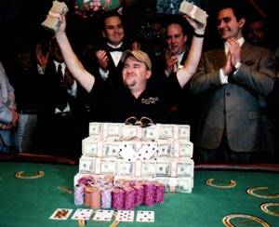
Computational game theory in AI: The challenge of poker….

Slide 3
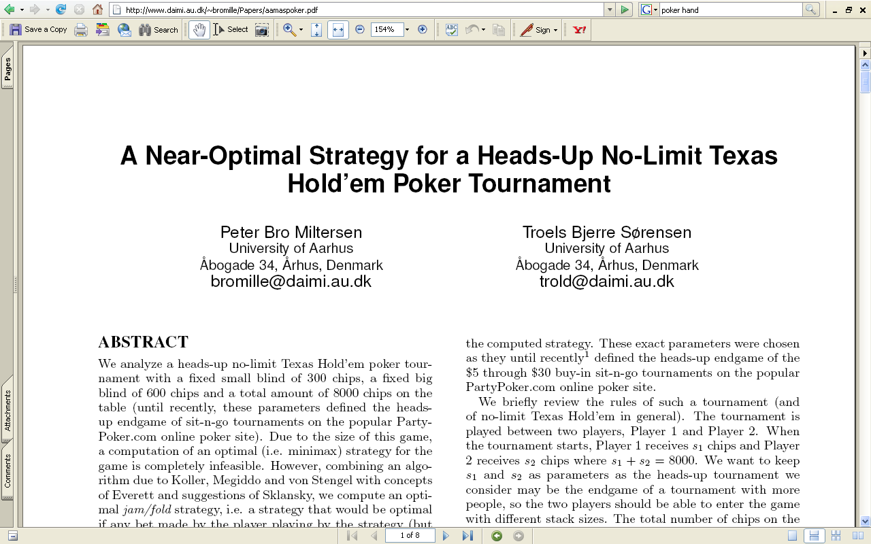
Values and optimal strategies
My most downloaded paper.
Download rate > 2*(combined rate of other papers)

Slide 4
Game theory in
(most of) Economics:
Computational game theory in
(most of) CAV and (some of) AI:
Descriptive
Prescriptive
For
2-player 0-sum games
What is the outcome when rational agents interact?
What should we do to win?
Stability concept:
Guarantee concept:
Nash equilibrium
=
Maximin/Minimax
Refined stability notions:
Sequential equilibrium
Trembling hand perfection
Stronger guarantees?
Quasiperfect equilibrium
Proper equilibrium
Most of this morning

Slide 5
Computational game theory in CAV vs. Computational game theory in AI
Main challenge in CAV: Infinite duration
Main challenge in AI: Imperfect information

Slide 6
Plan
Representing finite-duration, imperfect information, two-player zero-sum games and computing minimax strategies.
Issues with minimax strategies.
Equilibrium refinements (a crash course) and how refinements resolve the issues, and how to modify the algorithms to compute refinements.
(If time) Beyond the two-player, zero-sum case.

Slide 7
(Comp.Sci.) References
D. Koller, N. Megiddo, B. von Stengel. Fast algorithms for finding randomized strategies in game trees. STOC’94. doi:10.1145/195058.195451
P.B. Miltersen and T.B. Sørensen. Computing a quasi-perfect equilibrium of a two-player game. Economic Theory 42. doi:10.1007/s00199-009-0440-6
P.B. Miltersen and T.B. Sørensen. Fast algorithms for finding proper strategies in game trees. SODA’08. doi:10.1145/1347082.1347178
P.B. Miltersen. Trembling hand-perfection is NP-hard. arXiv:0812.0492v1

Slide 8
How to make a (2-player) poker bot?
How to represent and solve two-player, zero-sum games?
Two well known examples:
  Perfect information games
  Matrix games

Slide 9
Perfect Information Game (Game tree)
5
2
6
1
5

Slide 10
Backwards induction (Minimax evaluation)
5
2
6
1
5

Slide 11
Backwards induction (Minimax evaluation)
5
2
6
6
1
5

Slide 12
Backwards induction (minimax evaluation)
5
5
2
6
6
1
5
The stated strategies are minimax: They assure the best possible payoff against a worst case opponent. Also they are Nash: They are best responses against each other.

Slide 13
Matrix games
Matching Pennies:
Guess head up
Guess tails up
-1 | 0
0 | -1
Hide heads up
Hide tails up

Slide 14
Solving matrix games
Matching Pennies:
Guess head up
Guess tails up
-1 | 0
0 | -1
Hide heads up
1/2
Hide tails up
1/2
1/2
1/2
Mixed strategies
The stated strategies are minimax: They assure the best possible payoff against a worst case opponent. Also they are Nash: They are best responses against each other.

Slide 15
Solving matrix games
Minimax mixed strategies for matrix games are found using linear programming.
Von Neuman’s minmax theorem: Pairs of minimax strategies are exactly the Nash equililbria of a matrix games.

Slide 16
How to make a (2-player) poker bot?
Unlike chess, poker is a game of imperfect information.
Unlike matching pennies, poker is an extensive (or sequential) game.
Can one combine the two very different algorithms (backwards induction and linear programming) to solve such games?

Slide 17
Matching pennies in extensive form
1
Player 1 hides a penny either heads up or tails up.
Player 2 does not know if the penny is heads of or tails up, but guesses which is the case.
If he guesses correctly, he gets the penny.
Information set
2
2
0
-1
0
-1
Strategies must select the same (possibly mixed) action for each node in the information set.

Slide 18
Extensive form games
Guess the Ace:
R
A deck of card is shuffled
Either A♠ is the top card or not
Player 1 does not know if A♠ is the top card or not.
He can choose to end the game.
If he does, no money is exchanged.
Player 2 should now guess if A♠ is the top card or not (he cannot see it).
If he guesses correctly, Player 1 pays him $1000.
1/52
51/52
Information set
1
1
0
0
2
2
-1000
0
0
-1000
How should Player 2 play this game?

Slide 19
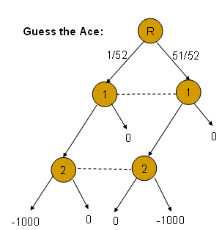
How to solve?
Guess A♠
Guess Other
Stop
0 | 0
-19.23 | -980.77
Play
Extensive form games can be converted into matrix games!

Slide 20
The rows and columns
A pure strategy for a player (row or column in matrix) is a vector consisting of one designated action to make in each information set belonging to him.
A mixed strategy is a distribution over pure strategies.

Slide 21
Done?
Guess A♠
Guess Other
Stop
0 | 0
-19.23 | -980.77
Play
Exponential blowup in size!
Extensive form games can be converted into matrix games!

Slide 23
LL

Slide 24
LL
LR

Slide 25
LL
LR
RL

Slide 26
LL
LR
RL
RR
n information sets each with binary choice ! 2^{n} columns

Slide 27
Behavior strategies (Kuhn, 1952)
A behavior strategy for a player is a family of probability distributions, one for each information set, the distribution being over the actions one can make there.

Slide 28
Behavior strategies
Guess the Ace:
R
1/52
51/52
1
1
1/2
1/2
1/2
1/2
0
0
2
2
0
1
0
1
-1000
0
0
-1000

Slide 29
Behavior strategies
Unlike mixed strategies, behavior strategies are compact objects.
For games of perfect recall, behavior strategies and mixed strategies are equivalent (Kuhn, 1952).
Can we find minimax behavior strategies efficiently?
Problem: The minimax condition is no longer described by a linear program!

Slide 30
Realization plans (sequence form) (Koller-Megiddo-von Stengel, 1994)
Given a behavior strategy for a player, the realization weight of a sequence of moves is the product of probabilities assigned by the strategy to the moves in the sequence.
If we have the realization weights for all sequences (a realization plan), we can deduce the corresponding behavior strategy (and vice versa).

Slide 31
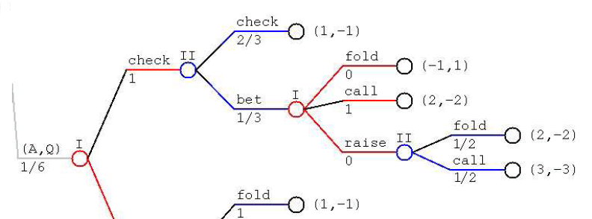
Behavior strategies

Slide 32
Realization plans
2/3
0
1
1
1/6
1/3
0
1/6
(1,0,1,0,….) is a realization plan for Player I
(2/3, 1/3, 1/6, 1/6, …) is a realization plan for Player II

Slide 33
Crucial observation
(Koller-Megiddo-von Stengel 1994)
The set of valid realization plans for each of the two players (for games of perfect recall) is definable by a set of linear equations and positivity.
The expected outcome of the game if Player 1 playing using realization plan x and Player 2 is playing using realization plan y is given by a bilinear form x^{T}Ay.
This implies that minimax realization plans can be found efficiently using linear programming!

Slide 34
Optimal response to fixed x.
If MAXs plan is fixed to x, the best response by MIN is given by:
Minimize (x^{T}A)y so that Fy = f, y ¸ 0.
(Fx = f, y ¸ 0 expressing that y is a realization plan.)
The dual of this program is:
Maximize f^{T} q so that F^{T} q · x^{T} A.

Slide 35
What should MAX do?
If MAX plays x he should assume that MIN plays so that he obtains the value given by Maximize f^{T} q so that F^{T} q · x^{T} A.
MAX wants to minimize this value, so his maximin strategy y is given by Maximize f^{T}q so that F^{T} q · x^{T} A, Ex = e, x ¸ 0.
(Ex = e, x ¸ 0 expressing that x is a realization plan)

Slide 36
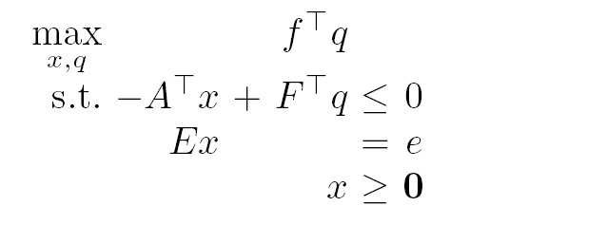
KMvS linear program
One constraint for each
action (sequence)
of player 2
x is valid
realization plan
x – Realization plan for Player 1
q – a “value” for each information set of Player 2

Slide 37
Up or down?
Max q
q=1, x_{u} = 1, x_{d} = 0
q · 5
q · 6 x_{u} + 5 x_{d}
5
x_{u} + x_{d} = 1
q
x_{u}, x_{d} ¸ 0
2
x_{u}
6
1
x_{d}
5
Intuition:Left hand side of inequality in solution is what Player 2 could achieve, right hand side is what he actually achieves by this action.

Slide 38
KMvS algorithm in action
Billings et al., 2003: Solve abstraction of heads-up limit Texas Hold’Em.
Gilpin and Sandholm 2005-2006: Fully solve limit Rhode Island Hold’Em. Better abstraction for limit Texas Hold’Em.
Miltersen and Sørensen 2006: Rigorous approximation to optimal solution of no-limit Texas Hold’Em tournament.
Gilpin, Sandholm and Sørensen 2007: Applied to 15 GB abstraction of limit Texas Hold’Em.
It is included in the tool GAMBIT. Let’s try the GAMBIT implementation on Guess The Ace….

Slide 39
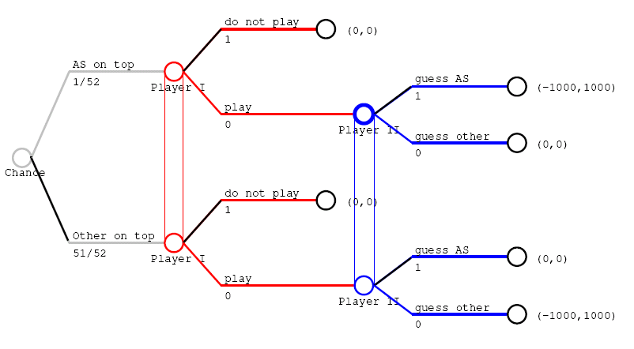
Guess-the-Ace, Nash equilibrium found by Gambit by KMvS algorithm

Slide 40
Complaints!
[..] the strategies are not guaranteed to take advantage of mistakes when they become apparent. This can lead to very counterintuitive behavior. For example, assume that player 1 is guaranteed to win $1 against an optimal player 2. But now, player 2 makes a mistake which allows player 1 to immediately win $10000. It is perfectly consistent for the ‘optimal’ (maximin) strategy to continue playing so as to win the $1 that was the original goal.
Koller and Pfeffer, 1997.
If you run an=1 bl=1 it tells you that you should fold some hands (e.g. 42s) when the small blind has only called, so the big blind could have checked it out for a free showdown but decides to muck his hand. Why is this not necessarily a bug? (This had me worried before I realized what was happening).
Selby, 1999.

Slide 41

Plan
Representing finite-duration, imperfect information, two-player zero-sum games and computing minimax strategies.
Issues with minimax strategies.
Equilibrium refinements (a crash course) and how refinements resolve the issues, and how to modify the algorithms to compute refinements.
(If time) Beyond the two-player, zero-sum case.

Slide 42
Equilibrium Refinements
Nash Eq.
(Nash 1951)
Subgame Perfect Eq
(Selten 1965)
(Normal form)
Trembling hand perfect Eq.
(Selten 1975)
Sequential Eq.
(Kreps-Wilson 1982)
(Extensive form)
Trembling hand perfect eq.
(Selten 1975)
Quasiperfect eq.
(van Damme 1991)
Proper eq.
(Myerson 1978)

Slide 43
Equilibrium Refinements
Nash Eq.
(Nash 1951)
Nobel prize winners
Subgame Perfect Eq
(Selten 1965)
(Normal form)
Trembling hand perfect Eq.
(Selten 1975)
Sequential Eq.
(Kreps-Wilson 1982)
(Extensive form)
Trembling hand perfect eq.
(Selten 1975)
Quasiperfect eq.
(van Damme 1991)
Proper eq.
(Myerson 1978)

Slide 44

Equilibrium Refinements
Nash Eq.
(Nash 1951)
Subgame Perfect Eq
(Selten 1965)
(Normal form)
Trembling hand perfect Eq.
(Selten 1975)
Sequential Eq.
(Kreps-Wilson 1982)
(Extensive form)
Trembling hand perfect eq.
(Selten 1975)
Quasiperfect eq.
(van Damme 1991)
For some games, impossible to achieve both! (Mertens 1995)
Proper eq.
(Myerson 1978)

Slide 45
Subgame perfection (Selten ’1965)
First attempt at capturing sequential rationality.
An equilibrium is subgame perfect if it induces an equilibrium in all subgames.
A subgame is a subtree of the extensive form that does not break any information sets.

Slide 46


Doomsday Game
(0,0)
2
Peaceful
co-existence
(-1,1)
Invasion and
surrender
1
(-100,-100)

Slide 47
Doomsday Game
(0,0)
2
(-1,1)
1
Nash Equilibrium 1
(-100,-100)

Slide 48
Doomsday Game
(0,0)
2
(-1,1)
1
Nash Equilibrium 2
(-100,-100)

Slide 49
Doomsday Game
(-1,1)
1
Nash Equilibrium 2
(-100,-100)

Slide 50
Doomsday Game
(0,0)
2
(-1,1)
1
Non-credible threat
Nash Equilibrium 2
(-100,-100)
is not subgame perfect.

Slide 51
Nash eq. found by backwards induction
5
5
2
6
6
1
5

Slide 52
Another Nash equilibrium!
Not subgame perfect!
In zero-sum games, sequential rationality is not so much
about making credible threats as about not returning gifts
5
2
6
1
5

Slide 53
How to compute a subgame perfect equilibrium in a zero-sum game
Solve each subgame separately.
Replace the root of a subgame with a leaf with its computed value.

Slide 54

Guess-the-Ace, bad Nash equilibrium found by Gambit by KMvS algorithm
It’s subgame perfect!

Slide 55
(Extensive form) trembling hand perfection (Selten’75)
Perturbed game: For each information set, associate a parameter ² > 0 (a tremble). Disallow behavior probabilities smaller than this parameter.
A limit point of equilibria of perturbed games as ² ! 0 is an equilibrium of the original game and called trembling hand perfect.
Intuition: Think of ² as an infinitisimal (formalised in paper by Joe Halpern).

Slide 56
Doomsday Game
(0,0)
1-²
2
²
(-1,1)
1
Non-credible threat
Nash Equilibrium 2
(-100,-100)
is not trembling hand perfect: If Player 1 worries just a little bit that Player 2 will attack, he will not commit himself to triggering the doomsday device

Slide 57
Guess-the-Ace, Nash equilibrium found by Gambit by KMvS algorithm
It’s not trembling hand perfect!

Slide 58
Computational aspects
Can an extensive form trembling-hand perfect equilibrium be computed for a given zero-sum extensive form game (two player, perfect recall) in polynomial time?
Open problem(!) (I think), but maybe not too interesting, as…

Slide 59
Equilibrium Refinements
Nash Eq.
(Nash 1951)
Subgame Perfect Eq
(Selten 1965)
(Normal form)
Trembling hand perfect Eq.
(Selten 1975)
Sequential Eq.
(Kreps-Wilson 1982)
(Extensive form)
Trembling hand perfect eq.
(Selten 1975)
Quasiperfect eq.
(van Damme 1991)
For some games, impossible to achieve both! (Mertens 1995)
Proper eq.
(Myerson 1978)

Slide 60
(Normal form) trembling hand perfect equilibria
Transform the game from extensive form to normal form.
Transform the normal form back to an extensive form with just one information set for each player and apply the definition of extensive form trembling hand perfect equilibria.
For a two-player game, a Nash equilibrium is normal form perfect if and only if it consists of two undominated strategies.

Slide 61
Mertens’ voting game
Two players must elect one of them to perform an effortless task. The task may be performed either correctly or incorrectly.
If it is performed correctly, both players receive a payoff of 1, otherwise both players receive a payoff of 0.
The election is by a secret vote.
  If both players vote for the same player, that player gets to perform the task.
  If each player votes for himself, the player to perform the task is chosen at random but is not told that he was elected this way.
  If each player votes for the other, the task is performed by somebody else, with no possibility of it being performed incorrectly.

Slide 62
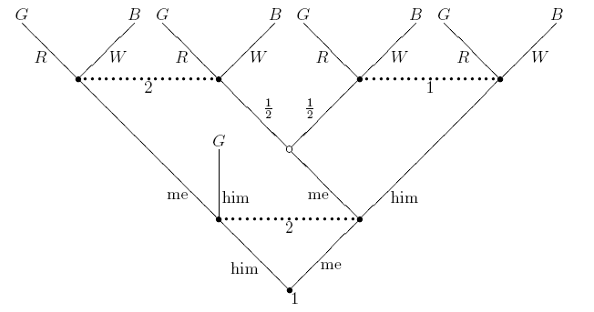

Slide 63
Normal form vs. Extensive form trembling hand perfection
The normal form and the extensive form trembling hand perfect equilibria of Mertens’ voting game are disjoint: Any extensive form perfect equilibrium has to use a dominated strategy.
One of the two players has to vote for the other guy.

Slide 64
What’s wrong with the definition of trembling hand perfection?
The extensive form trembling hand perfect equilibria are limit points of equilibria of perturbed games.
In the perturbed game, the players agree on the relative magnitude of the trembles.
This does not seem warranted!

Slide 65
Open problem
Is there a zero-sum game for which the extensive form and the normal form trembling hand perfect equilibria are disjoint?

Slide 66
Equilibrium Refinements
Nash Eq.
(Nash 1951)
Subgame Perfect Eq
(Selten 1965)
(Normal form)
Trembling hand perfect Eq.
(Selten 1975)
Sequential Eq.
(Kreps-Wilson 1982)
(Extensive form)
Trembling hand perfect eq.
(Selten 1975)
Quasiperfect eq.
(van Damme 1991)
For some games, impossible to achieve both! (Mertens 1995)
Proper eq.
(Myerson 1978)

Slide 67
Equilibrium Refinements
Nash Eq.
(Nash 1951)
Subgame Perfect Eq
(Selten 1965)
(Normal form)
Trembling hand perfect Eq.
(Selten 1975)
Sequential Eq.
(Kreps-Wilson 1982)
(Extensive form)
Trembling hand perfect eq.
(Selten 1975)
Quasiperfect eq.
(van Damme 1991)
Proper eq.
(Myerson 1978)

Slide 68
Computing a normal form perfect equilibrium of a zero-sum game, easy hack!
Compute the value of the game using KMvS algorithm.
Among all behavior plans achieving the value, find one that maximizes payoff against some fixed fully mixed strategy of the opponent.
But: A normal form perfect equilibrium is not guaranteed to be sequentially rational (keep gifts).

Slide 69
Example of ”bad”(?) behavior in a normal form perfect equilibrium
Rules of the game:
  Player 2 can either stop the game or give Player 1 a dollar.
  If Player 1 gets the dollar, he can either stop the game or give Player 2 the dollar back.
  If Player 2 gets the dollar, he can either stop the game or give Player 1 two dollars.
It is part of a normal form perfect equilibrium for Player 1 to give the dollar back if he gets it.

Slide 70
Equilibrium Refinements
Nash Eq.
(Nash 1951)
Subgame Perfect Eq
(Selten 1965)
(Normal form)
Trembling hand perfect Eq.
(Selten 1975)
Sequential Eq.
(Kreps-Wilson 1982)
(Extensive form)
Trembling hand perfect eq.
(Selten 1975)
Quasiperfect eq.
(van Damme 1991)
Proper eq.
(Myerson 1978)

Slide 71
Sequential Equilibria
(Kreps and Wilson, 1982)
In addition to prescribing two strategies, the equilibrium prescribes to every information set a belief: A probability distribution on nodes in the information set.
At each information set, the strategies should be “sensible”, given the beliefs.
At each information set, the beliefs should be “sensible”, given the strategies.
Unfortunately, a sequential equilibrium may use dominated strategies.

Slide 72
Sequential equilibrium using a dominated strategy
Rules of the game:
  Player 1 either stops the game or asks Player 2 for a dollar.
  Player 2 can either refuse or give Player 1 a dollar
It is part of a sequential equilibrium for Player 1 to stop the game and not ask Player 2 for a dollar.
Intuition: A sequential equilibrium reacts correctly to mistakes done in the past but does not anticipate mistakes that may be made in the future.

Slide 73
Equilibrium Refinements
Nash Eq.
(Nash 1951)
Subgame Perfect Eq
(Selten 1965)
(Normal form)
Trembling hand perfect Eq.
(Selten 1975)
Sequential Eq.
(Kreps-Wilson 1982)
(Extensive form)
Trembling hand perfect eq.
(Selten 1975)
Quasiperfect eq.
(van Damme 1991)
Proper eq.
(Myerson 1978)

Slide 74
Quasi-perfect equilibrum (van Damme, 1991)
A quasi-perfect equilibrium is a limit point of ²-quasiperfect behavior strategy profile as ² > 0.
An ²-quasi perfect strategy profile satisfies that if some action is not a local best response, it is taken with probability at most ².
An action a in information set h is a local best response if there is a plan ¼ for completing play after taking a, so that best possible payoff is achieved among all strategies agreeing with ¼ except possibly at t h and afterwards.
Intuition: A player trusts himself over his opponent to make the right decisions in the future – this avoids the anomaly pointed out by Mertens.
By some irony of terminology, the ”quasi”-concept seems in fact far superior to the original unqualified perfection. Mertens, 1995.

Slide 75
Computing quasi-perfect equilibrium M. and Sørensen, SODA’06 and Economic Theory, 2010.
Shows how to modify the linear programs of Koller, Megiddo and von Stengel using symbolic perturbations ensuring that a quasi-perfect equilibrium is computed.
Generalizes to non-zero sum games using linear complementarity programs.
Solves an open problem stated by the computational game theory community: How to compute a sequential equilibrium using realization plan representation (McKelvey and McLennan) and gives an alternative to an algorithm of von Stengel, van den Elzen and Talman for computing an nromal form perfect equilibrium.

Slide 76
Perturbed game G(ε)
G(ε) is defined as G except that we put a constraint on the mixed strategies allowed:
A position that a player reaches after making d moves must have realization weight at least ε^{d}.

Slide 77
Facts
G(ε) has an equilibrium for sufficiently small ε>0.
An expression for an equilibrium for G(ε) can be found in practice using the simplex algorithm, keeping ε a symbolic parameter representing sufficiently small value.
An expression can also be found in worst case polynomial time by the ellipsoid algorithm.

Slide 78
Theorem
When we let ε ! 0 in the behavior strategy equilibrium found for G(ε), we get a behavior strategy profile for the original game G. This can be done symbolically
This strategy profile is a quasi-perfect equilibrium for G.
… note that this is perhaps surprising - one could have feared that an extensive form perfect equilibrium was computed.

Slide 79

Questions about quasi-perfect equilibria
Is the set of quasi-perfect equilibria of a zero-sum game 2-player game a Cartesian product (as the sets of Nash and normal-form proper equilibria are)?
Can the set of quasi-perfect equilibria be polyhedrally characterized/computed (as the sets of Nash and normal-form proper equilibria can)?

Slide 80
All complaints taken care of?
[..] the strategies are not guaranteed to take advantage of mistakes when they become apparent. This can lead to very counterintuitive behavior. For example, assume that player 1 is guaranteed to win $1 against an optimal player 2. But now, player 2 makes a mistake which allows player 1 to immediately win $10000. It is perfectly consistent for the ‘optimal’ (maximin) strategy to continue playing so as to win the $1 that was the original goal.
Koller and Pfeffer, 1997.
If you run an=1 bl=1 it tells you that you should fold some hands (e.g. 42s) when the small blind has only called, so the big blind could have checked it out for a free showdown but decides to muck his hand. Why is this not necessarily a bug? (This had me worried before I realized what was happening).
Selby, 1999.

Slide 81
Matching Pennies on Christmas Morning
Player 1 hides a penny.
If Player 2 can guess if it is heads up or tails up, he gets the penny.
How would you play this game (Matching Pennies) as Player 2?
After Player I hides the penny but before Player 2 guesses, Player I has the option of giving Player 2 another penny, no strings attached (after all, it’s Christmas).
How would you play this game as Player 2?

Slide 82
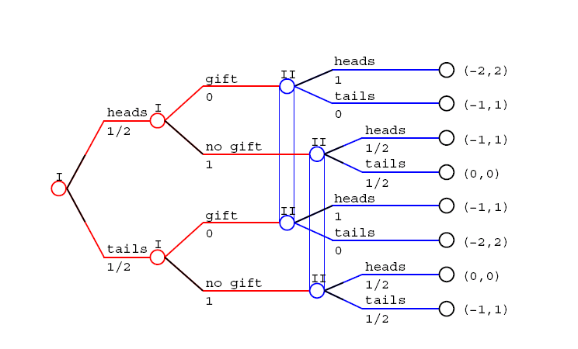
Matching Pennies on Christmas Morning, bad Nash equilibrium
The bad equilibrium is quasi-perfect!

Slide 83
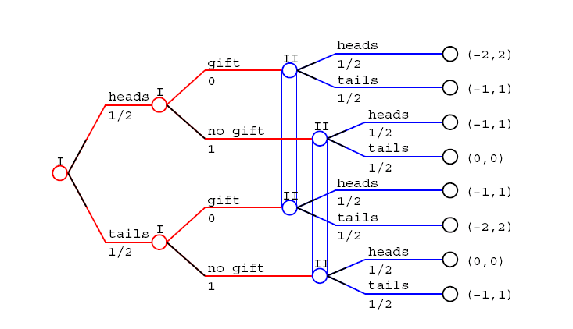
Matching Pennies on Christmas Morning, good equilibrium
The good equilibrium is not a basic solution to the KMvS LP!

Slide 84
How to celebrate Christmas without losing your mind
Nash Eq.
(Nash 1951)
Subgame Perfect Eq
(Selten 1965)
(Normal form)
Trembling hand perfect Eq.
(Selten 1975)
Sequential Eq.
(Kreps-Wilson 1982)
(Extensive form)
Trembling hand perfect eq.
(Selten 1975)
Quasiperfect eq.
(van Damme 1991)
Proper eq.
(Myerson 1978)

Slide 85
Normal form proper equilibrium
(Myerson ’78)
A limit point as ε ! 0 of ε-proper strategy profiles.
An ε-proper strategy profile are two fully mixed strategies, so that for any two pure strategies i,j belonging to the same player, if j is a worse response than i to the mixed strategy of the other player, then p(j) · ε p(i).

Slide 86
Normal form proper equilibrium
(Myerson ’78)
Intuition:
Players assume that the other player may make mistakes.
Players assume that mistakes made by the other player are made in a rational manner.

Slide 87
Normal-form properness
The good equilibrium of Penny-Matching-on-Christmas-Morning is the unique normal-form proper one.
Properness captures the assumption that mistakes are made in a “rational fashion”. In particular, after observing that the opponent gave a gift, we assume that apart from this he plays sensibly.

Slide 88
Properties of Proper equilibria of zero sum games (van Damme, 1991)
The set of proper equilibria is a Cartesian product D₁ £ D₂ (as for Nash equlibria).
Strategies of D_{i} are payoff equivalent: The choice between them is arbitrary against any strategy of the other player.

Slide 89
Miltersen and Sørensen, SODA 2008
For imperfect information games, a normal form proper equilibrium can be found by solving a sequence of linear programs, based on the KMvS programs.
The algorithm is based on finding solutions to the KMvS “balancing” the slack obtained in the inequalitites.

Slide 90
Up or down?
Max q
q · 5
q · 6 x_{u} + 5 x_{d}
5
x_{u} + x_{d} = 1
q
x_{u}, x_{d} ¸ 0
2
x_{u}
6
1
x_{d}
5

Slide 91
“Bad” optimal solution
Max q
q=1, x_{u} = 0, x_{d} = 1
q · 5
No slack
q · 6 x_{u} + 5 x_{d}
5
x_{u} + x_{d} = 1
q
x_{u}, x_{d} ¸ 0
2
x_{u}
6
1
x_{d}
5

Slide 92
Good optimal solution
Max q
q=1, x_{u} = 1, x_{d} = 0
q · 5
Slack!
q · 6 x_{u} + 5 x_{d}
5
x_{u} + x_{d} = 1
q
x_{u}, x_{d} ¸ 0
2
x_{u}
6
1
x_{d}
5
Intuition: Left hand side of inequality in solution is what Player 2 could achieve, right hand side is what he actually achieves by taking the action, so slack is good!

Slide 93
The algorithm
Solve original KMvS program.
Identify those inequalities that may be satisfied with slack in some optimal solution. Intuition: These are the inequalities indexed by action sequences containing mistakes.
Select those inequalities corresponding to action sequences containing mistakes but having no prefix containing mistakes.
Find the maximin (min over the inequalities) possible slack in those inequalities.
Freeze this slack in those inequalities (strengthening the inequalities)

Slide 94
Proof of correctness
Similar to proof of correctness of “Dresher’s procedure” – characterizing the proper equilibria of a matrix game.
Step 1: Show that any proper equilibrium “survives” the iteration.
Step 2: Show that all strategies that survive are “payoff”-equivalent.

Slide 95
Left or right?
1
Unique proper eq.:
2/3
1/3
2
2
1
0
2
0

Slide 96
Interpretation
If Player 2 never makes mistakes the choice is arbitrary.
We should imagine that Player 2 makes mistakes with some small probability but can train to avoid mistakes in either the left or the right node.
In equilibrium, Player 2 trains to avoid mistakes in the “expensive” node with probability 2/3.
Similar to “meta-strategies” for selecting chess openings.
The perfect information case is easier and can be solved in linear time by “a backward induction procedure” without linear programming.
This procedure assigns three values to each node in the tree, the “real” value, an “optimistic” value and a “pessimistic” value.

Slide 97
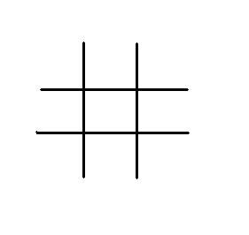
The unique proper way to play tic-tac-toe
…. with probabiltiy 1/13

Slide 98
Questions about computing proper equilibria
Can a proper equilibrium of a general-sum bimatrix game be found by a “pivoting algorithm”? Is it in the complexity class PPAD? Can one convincingly argue that this is not the case?
Can an ²-proper strategy profile (as a system of polynomials in ²) for a matrix game be found in polynomial time). Motivation: This captures a “lexicographic belief structure” supporting the corresponding proper equilibrium.

Slide 99
Plan
Representing finite-duration, imperfect information, two-player zero-sum games and computing minimax strategies.
Issues with minimax strategies.
Equilibrium refinements (a crash course) and how refinements resolve the issues, and how to modify the algorithms to compute refinements.
(If time) Beyond the two-player, zero-sum case.

Slide 100
Finding Nash equilibria of general sum games in normal form
Daskalakis, Goldberg and Papadimitriou, 2005. Finding an approximate Nash equilibrium in a 4-player game is PPAD-complete.
Chen and Deng, 2005. Finding an exact or approximate Nash equilibrium in a 2-player game is PPAD-complete.
… this means that these tasks are polynomial time equivalent to each other and to finding an approximate Brower fixed point of a given continuous map.
This is considered evidence that the tasks cannot be performed in worst case polynomial time.
.. On the other hand, the tasks are not likely to be NP-hard.: If they are NP-hard, then NP=coNP.

Slide 101
Motivation and Interpretation
The computational lens
”If your laptop can’t find it neither can the market” (Kamal Jain)

Slide 102
What is the situation for equilibrium refinements?
Finding a refined equilibrium is at least as hard as finding a Nash equilibrium.
M., 2008: Verifying if a given equilibrium of a 3-player game in normal form is trembling hand perfect is NP-hard.

Slide 103
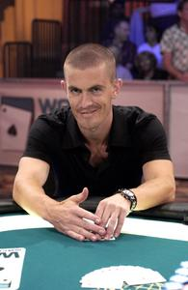
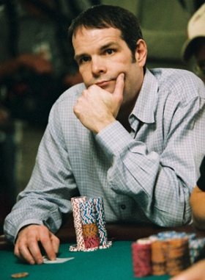
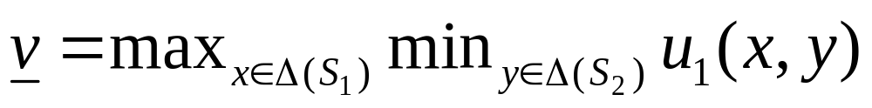
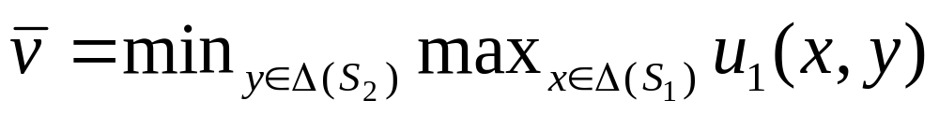
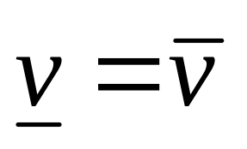
Two-player zero-sum games
Player 1:
Gus, the
Maximizer
Player 2 :
Howard, the
Minimizer
Maxmin value (lower value, security value):
Minmax value (upper value, threat value):
von Neuman’s minmax theorem
(LP duality):

Slide 104
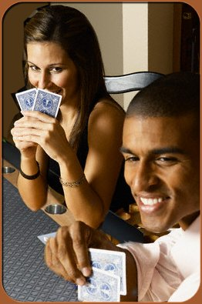
Three-player zero-sum games
Player 1:
Gus, the
Maximizer
Players 2 and 3:
Alice and Bob, the
Minimizers
“honest-but-married”
Maxmin value (lower value, security value):
Minmax value (upper value, threat value):
Uncorrelated mixed strategies.

Slide 105
Three-player zero-sum games
Player 1:
Gus, the
Maximizer
Players 2 and 3:
Alice and Bob, the
Minimizers
“honest-but-married”
Maxmin value (lower value, security value):
Minmax value (upper value, threat value):
Bad news:
Lower value · upper value but in general not =
Maxmin/Minmax not necessarily Nash
Minmax value may be irrational

Slide 106
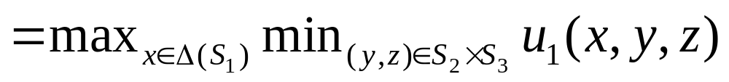
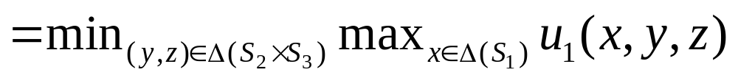
Why not equality?
Computable in P, given table of u₁
Maxmin value (lower value, security value):
Correlated mixed
strategy (married-and-dishonest!)
Minmax value (upper value, threat value):
Borgs et al., STOC 2008:
NP-hard to approximate, given table of u₁!

Slide 107
Borgs et al., STOC 2008
It is NP-hard to approximate the minmax-value of a 3-player n x n x n game with payoffs 0,1 (win,lose) within additive error 3/n².

Slide 108
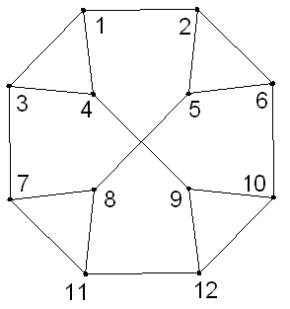
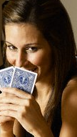

Proof – Hide and seek game
Alice and Bob hide in an
undirected graph.

Slide 109


Proof – Hide and seek game
Alice and Bob hide in an
undirected graph.
Gus, blindfolded, has to call
the location of one of them.
Alice is at
…. 8

Slide 110
Analysis
Optimal strategy for Gus
  Call arbitrary player at random vertex.
Optimal strategy for Alice and Bob
  Hide at random vertex
Lower value = upper value = 1/n.

Slide 111
Hide and seek game with colors
Alice and Bob hide in an
undirected graph.
.. and declare a color in
Gus, blindfolded, has to call
the location of one of them.
Alice is at
…. 8

Slide 112
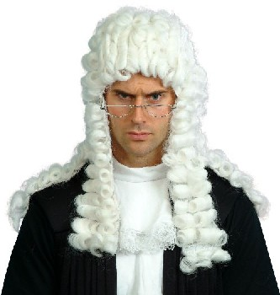
Hide and seek game with colors
Additional way in which
Gus may win: Alice and
Bob makes a declaration
inconsistent with 3-coloring.
Oh no
you don’t!

Slide 113
Hide and seek game with colors
Additional way in which
Gus may win: Alice and
Bob makes a declaration
inconsistent with 3-coloring.
Oh no
you don’t!

Slide 114
Analysis
If graph is 3-colorable, minmax value is 1/n: Alice and Bob can play as before.
If graph is not 3-colorable, minmax value is at least 1/n + 1/(3n²).

Slide 115
Reduction to deciding trembling hand perfection
Given a 3-player game G, consider the task of determining if the min-max of Player 1 value is bigger than ®+² or smaller than ®-².
Define G* by augmenting the strategy space of each player with a new strategy *.
Payoffs: Players 2 and 3 get 0, no matter what is played.
Player 1 gets ® if at least one player plays *, otherwise he gets what he gets in G.
Claim: (*,*,*) is trembling hand perfect in G* if and only if the minmax value of G is smaller than ® - ².

Slide 116
Intuition
If the minmax value is less than ® - ², he may believe that in the equilibrium (*,*,*) Players 2 and 3 may tremble and play the exactly the minmax strategy. Hence the equilibrium is trembling hand perfect.
If the minmax value is greater than ®+², there is no single theory about how Players 2 and 3 may tremble that Player 1 could not react to and achieve something better than ® by not playing *. This makes (*,*,*) imperfect,
Still, it seems that it is a ”reasonable” equilibrium if Player 1 does not happen to have a fixed belief about what will happen if Players 2 and 3 tremble(?)…..

Slide 117
Questions about NP-hardness of the general-sum case
Is deciding trembling hand perfection of a 3-player game in NP?
Deciding if an equilibrium in a 3-player game is proper is NP-hard (same reduction). Can properness of an equilibrium of a 2-player game be decided in P? In NP?

Slide 118
Thank you!

